Slide 1

Improving circulation and operations at Copenhagen City Libraries
Jakob Petersen
17th of October 2025

Slide 2
Agenda
INTRODUCTION
1
DEVELOPMENT OF CORE LIBRARY OPERATIONS
2
DIGITAL INITIATIVES
3
4

Slide 3
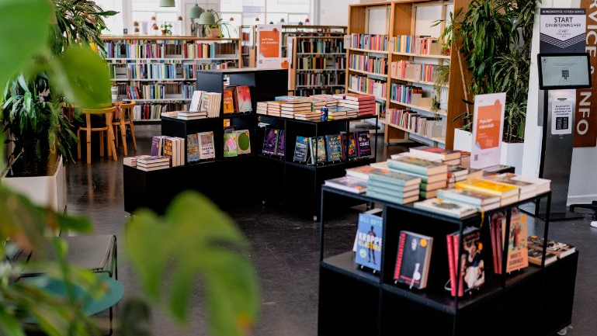
INTRODUCTION

Slide 4
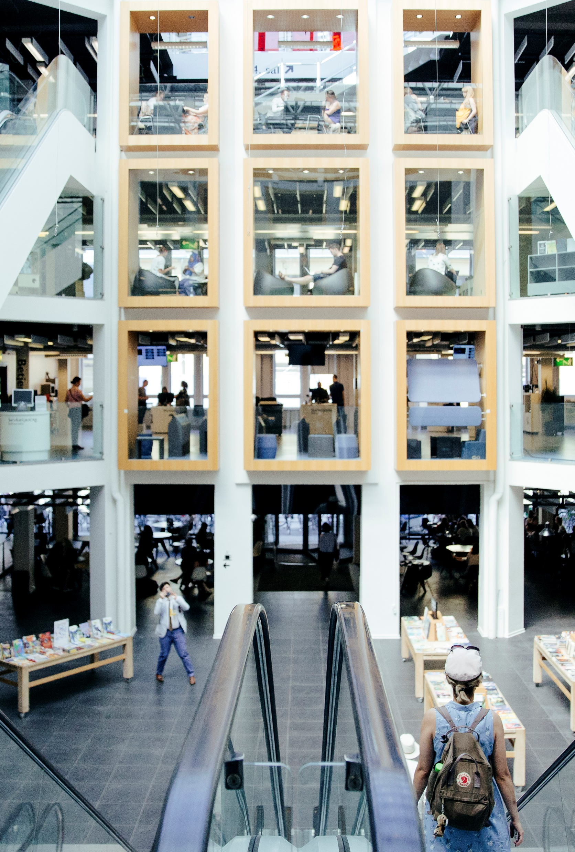
Introduction
Jakob Petersen
  Library Director and Head of Analysis and Development at The Culture and Leisure Administration
Responsible for Citywide
  Library functions (Logistics, Digital library and Call center, Library Acquisitions and library development)
  Development of culture houses, sports activities and events, tourism and service for expats, and communication
Experience
  Library director for +10 years at the City of Copenhagen
  Formerly responsible for national library development at The National Library Authority

Slide 5
Copenhagen City Government
City Council Copenhagen
The Finance Committee
The Technical and Environmental Committee
The Culture and Leisure Committee
The Children and Youth Committee
The Health and Care Committee
The Social Service Committee
The Employment and Integration Committee
The Culture and Leisure Administration
Libraries
Citizen’s service
Public education
Population Register
Sports Facilities
Cultural Houses
Museums
Grants for Theater
Music and Arts
Tourism
Events

Slide 6
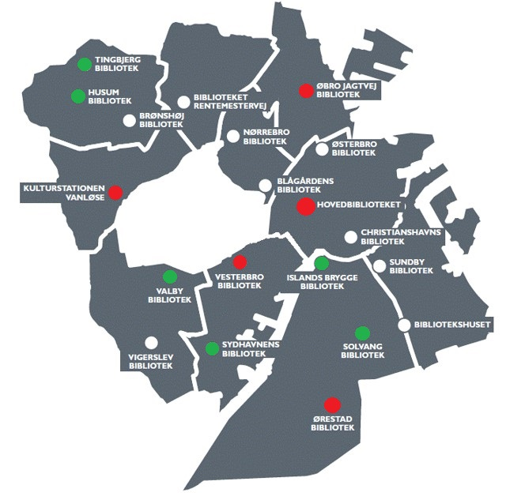
Copenhagen Libraries
20 libraries and one central sorting facility
Approx. 260 employees
3.657.000 book-loans (2024)
  2.700.000 physical books
  957.000 e-books and digital audiobooks
4.026.000 visitors (2024)
Approx. 850.000 physical materials (2024)
Approx. 110.000 e-books and digital audiobooks (2024)
The size of the dot indicates the size of the library (public-m² )
260-500 m² 500-1000 m² 1000-6000 m²

Slide 7
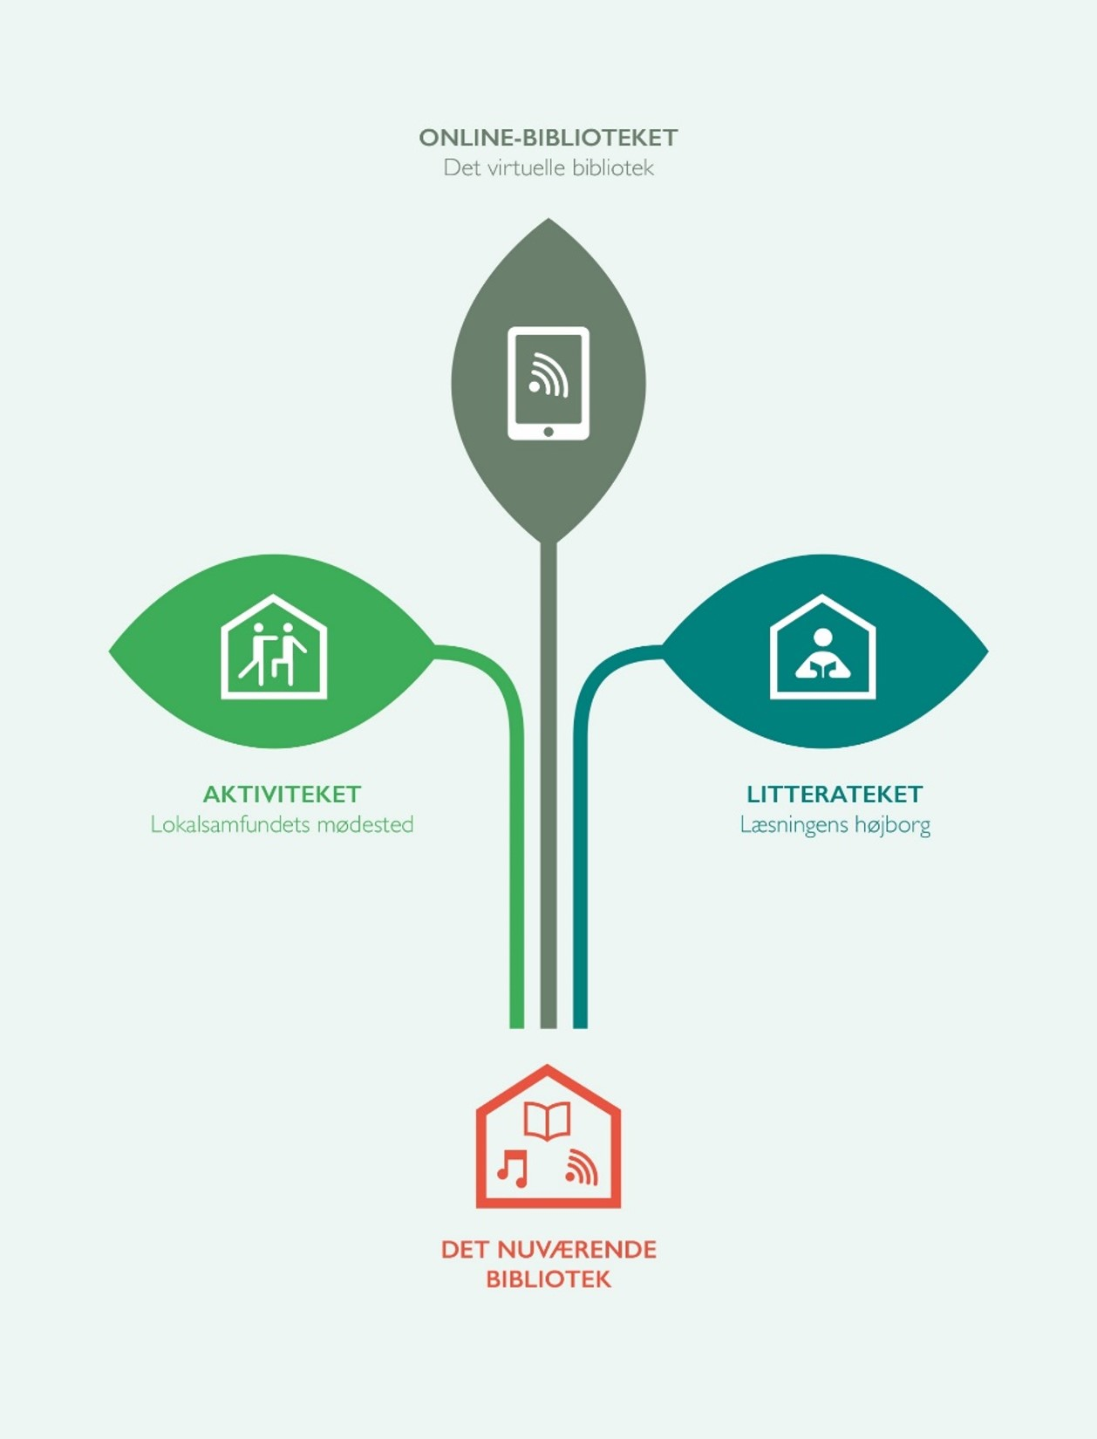
Current focus and issues
The Online Library
Focus on costs and rejection of tasks outside political mandate
Focus on literature and reading
  Preserving the role of literature in the daily lives of citizens especially children
Developing the core processes of the library through data, technology and specialization
Library services with focus on disadvantaged children and community building
  Outreach and geographically defined services
The Activity Place
Community meeting place
The Literature Place
The Stronghold of Reading
The Current Library

Slide 8
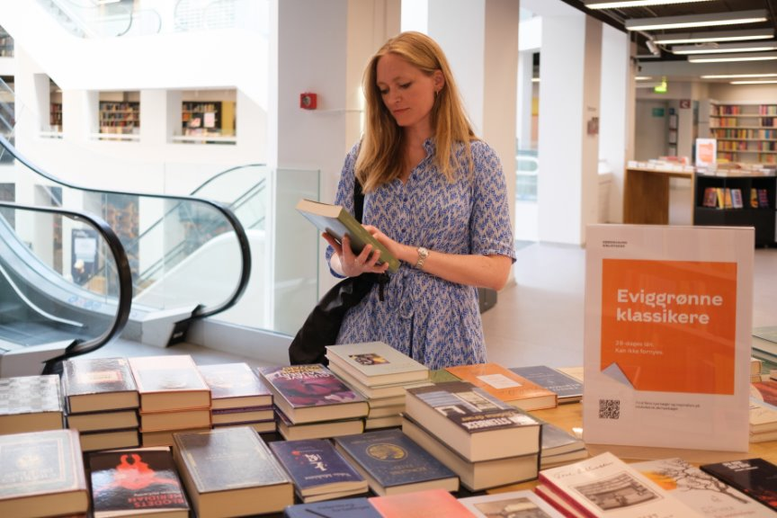
DEVELOPMENT OF CORE LIBRARY OPERATIONS

Slide 9
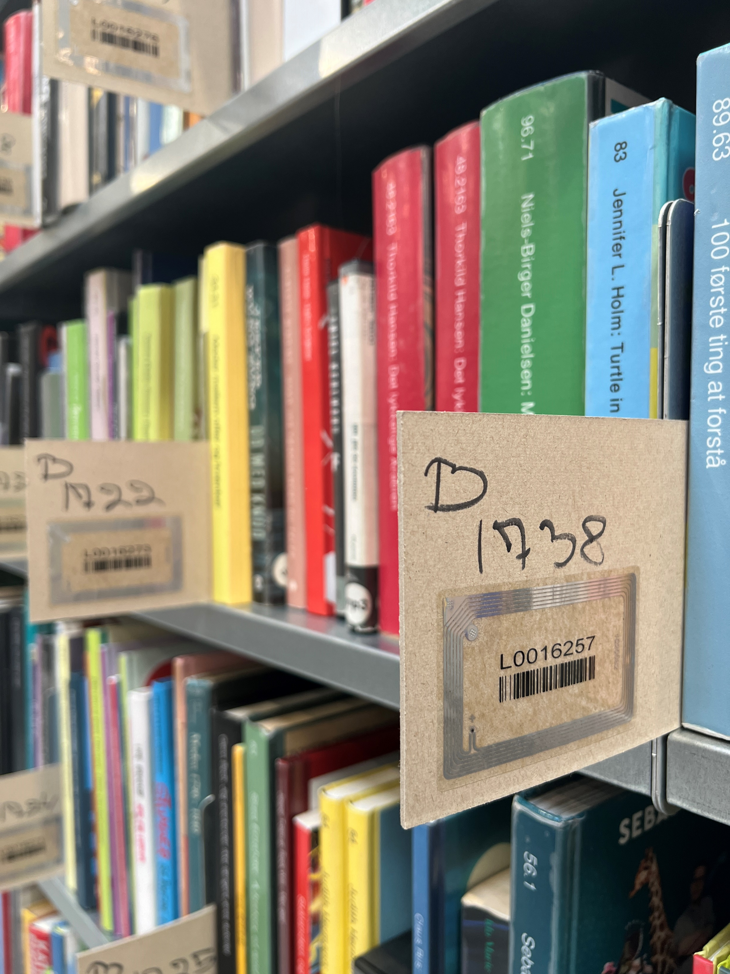
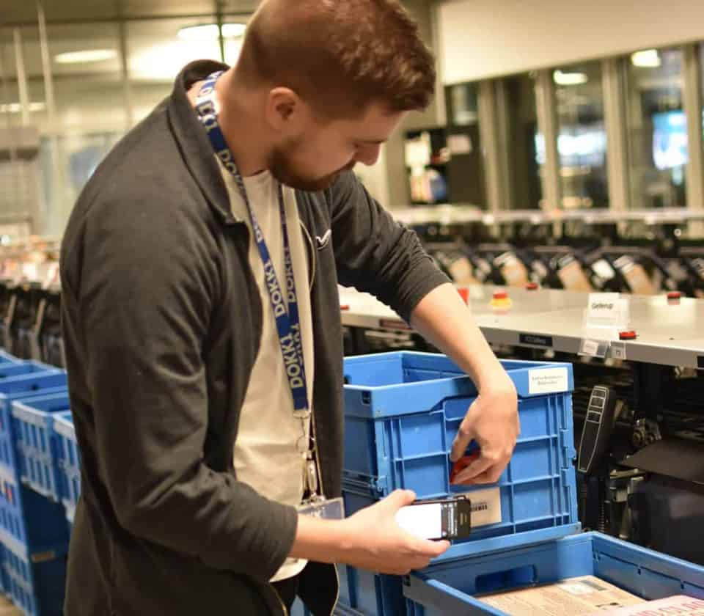
Intelligent Materials Management System (IMMS)
IMMS – logistics system that complement the library system
The system knows the exact location of every book as the book is scanned to its shelf or transport box
Supports the distribution of books between branches

Slide 10
Local and national circulation numbers
Circulation of printed books per 1.000 inhabitants
 | 2018 | 2019 | 2020 | 2021 | 2022 | 2023 | 2024
National average | 4.205 | 4.219 | 3.151 | 2.603 | 3.477 | 3.749 | 3.930
Copenhagen | 3.657 | 3.651 | 2.438 | 2.071 | 3.160 | 3.553 | 4.085

Slide 11
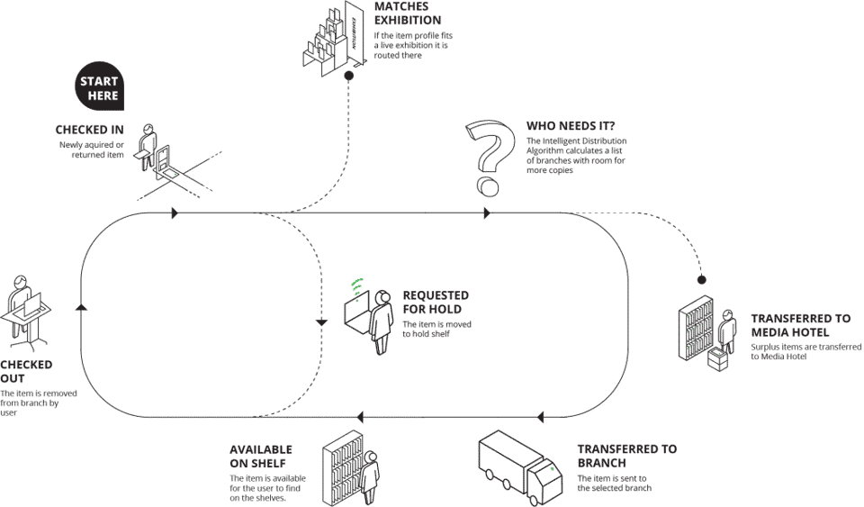
The journey of the book

Slide 12

The joint book collection of Copenhagen Libraries
Distribution of printed book loans 2024
Joint book collection for all 20 library
The flow of books is controlled by IMMS (Intelligent Material Management System)
The joint logistics system makes sure that books flow between libraries according to predefined collection profiles and the use of the collection.
Returned books are collected and put through an automated sorting machine that distributes books to individual libraries.
The distribution is based on which books, library users have reserved for delivery to their local branch and the individual library collection profile in IMMS
Children’s books
Adult books
Borrowed directly from bookcase
Borrowed from book display
Borrowed through reservations

Slide 13
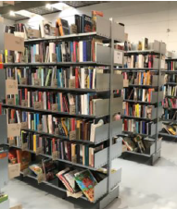
Stock items and off-the-shelf items
Shelving at local libraries
When books are shelved in the public library space, they need to be placed alphabetically for patrons to locate them
Shelving at central storage
When books are placed in the “hotel” they can be placed “randomly” if they are scanned so IMMS knows the location
When books are ordered IMMS can generate a pick-order with optimized walk lanes at the hotel
Shelving of books is 6 times faster at the hotel than in public library space and locating reserved books is twice as fast
  2,7 mil. yearly loans of physical books
  Shelving: 1,5 books pr. minute in library space
  Shelving: 10 books pr. minute at “hotel”

Slide 14
The business case ”More hospitality and efficient collection management”
Changing the core library operations through a business case
The purpose of the case was to increase circulation through better processes and better service
Specific initiatives:
1
New central sorting facility and new book hotel
Division of books in storage and off-the-shelf items
Increased use of book displays
Reorganization of logistics and collection management
Redesign og the library space in local branches
More hospitality
2
3
4
5
The economics of the business case
6
1,4 mil. Euros in one time investment
320.000 Euros in permanent savings

Slide 15
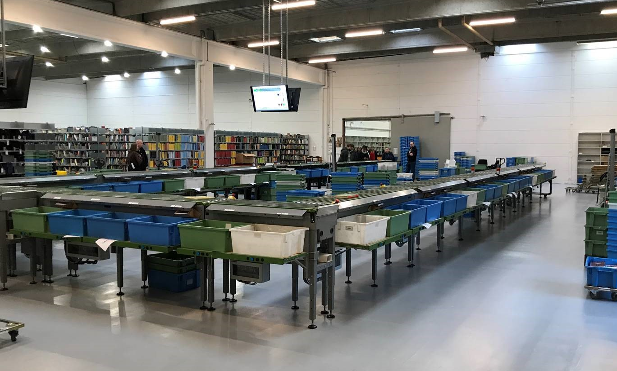
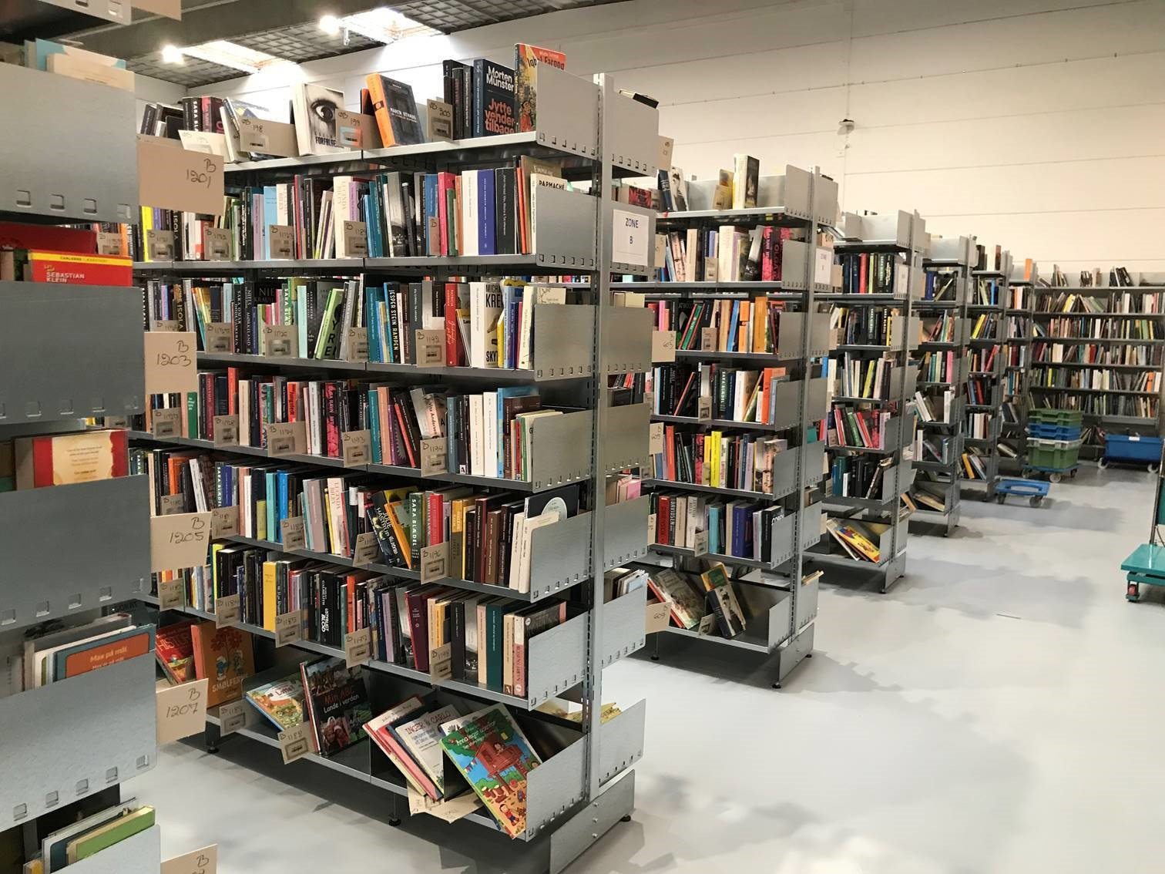
New central sorting facility and hotel in Albertslund
1
4,2 km extra shelves
Need for increased capacity
Almost all returned materials are collected and processed and distributed through the central sorting facility.
The central sorting facility is more efficient than local manual sorting and the distribution is more efficient based on the central facility
Increased capacity so more books are stored at the hotel and the logistics at the local libraries is reorganized
Larger sorting facility and hotel
The central sorting facility and book hotel of Copenhagen libraries was moved from a location in the city to an industrial areas in Albertslund on December 1st, 2020
The move provided space for joint library functions:
Tripling of the hotel capacity.
Expansion of the storage facility with 24 diverts/destinations
Processing of Interlibrary loans
Books to the doorstep – monthly delivery of books to citizens that through disability, old age or sickness are unable to come to the library
The larger rooms means that working conditions have been significantly improved

Slide 16


Separation of books in two groups: stock items and off-the-shelf items
2
Separation of books in order to ensure efficient handling
Shelving at the local library
Books placed in the library space need to be shelved systematically and alphabetically for patrons to locate them.
IMMS can identify which books are borrowed, which books are primarily reserved and which books that are never borrowed.
The collections of all 20 libraries was adjusted locally with more copies of books that are in demand at the local library (i.e. Children's books) and fewer of those that are typically reserved (i.e. study books).
Shelving at the hotel
Books placed at the hotel can be shelved ”randomly” as long as they are scanned to the shelf, so IMMS knows their location.
The system generates a pick order with optimal walking lanes when books are ordered.
It is 6 times faster to shelve books at the hotel and twice as fast to locate them compared to placement in the public library space.
125.000 boos was moved to the hotel creating room for more book displays, larger children’s libraries and more activities in the library space.
The collection at the local libraries are continuously adjusted based on data and professional assessments.

Slide 17



Which books are best suited as respectively stock items and off-the-shelf items?
Example
Book hotel
Local library
Books that are often reserved
Books often browsed
Ego: The thinking human from caveman to citizen of the world
(Placed in adult non-fiction)
Climate-happy-food
(Placed in adult non-fiction)
Borrowed through browsing = 8,33% Borrowed through reservations = 91,67%
Borrowed through browsing = 100%
Borrowed through reservations = 0%
Stock item
Off-the-shelf item

Slide 18
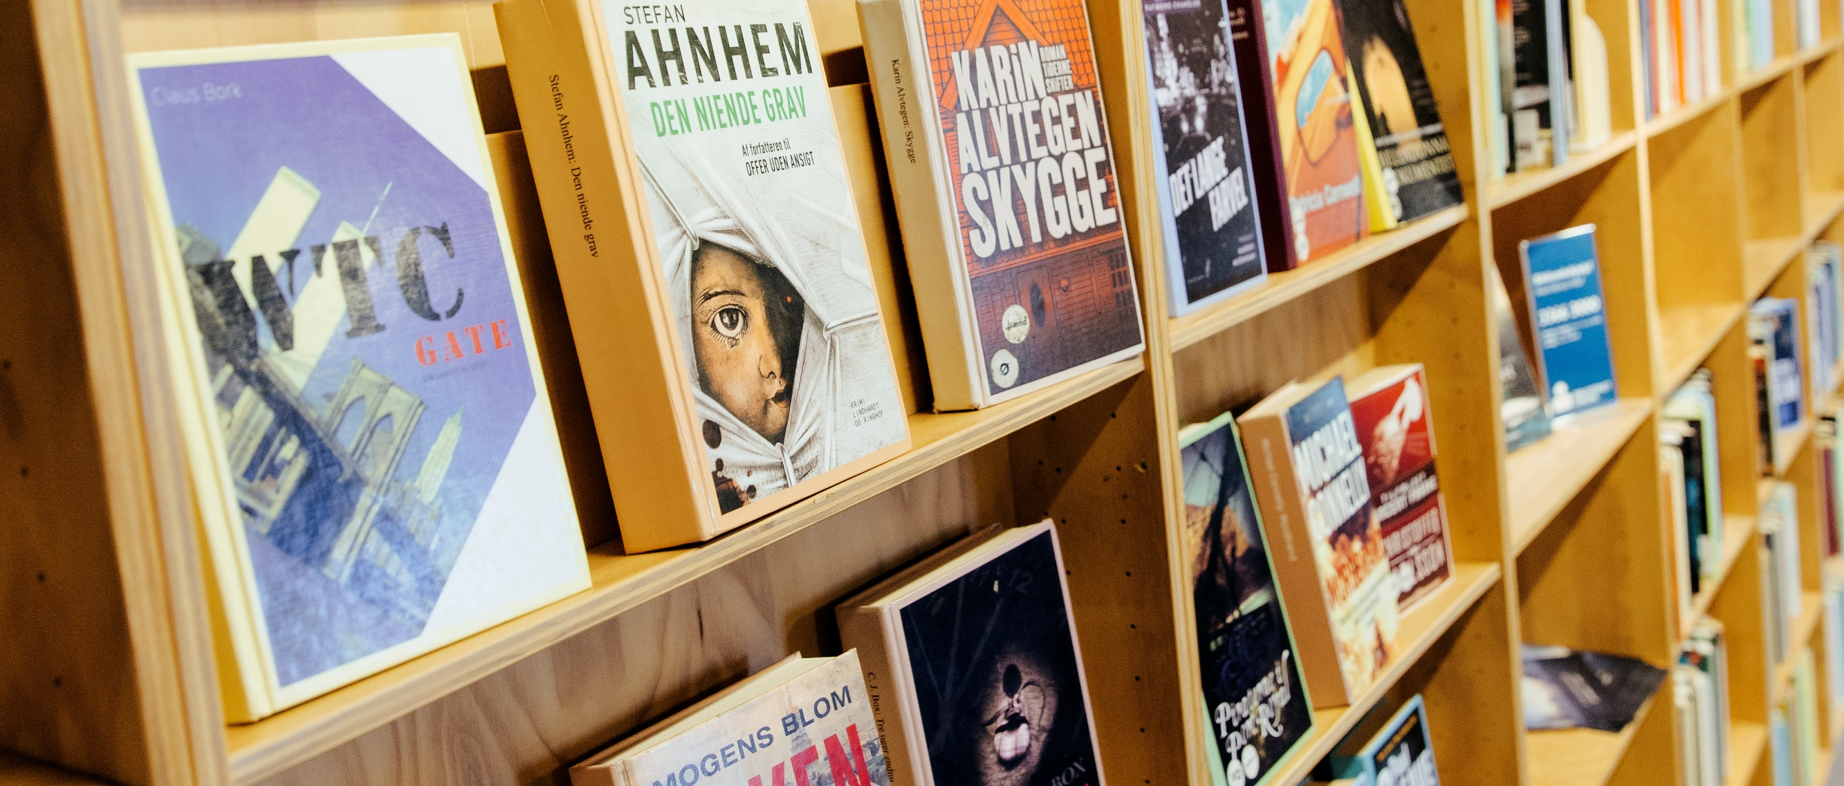
Increased use of book displays
3
Book displays work but are work-intensive
User interviews show that patrons want inspiration at the library.
Data from the main library shows that front-facing books are borrowed 5-7 times as much as books with the book spine facing patrons
Book displays are traditionally very work-intensive and it is time-consuming to located reserved books on a book display.
There was a need for innovation to offer more book displays with fewer resources.
More city-wide book displays in permanent categories
The number of book display was increased by a factor 5 to approximately 550. This created a good literary frame for hospitality
Permanent categories were developed for all 20 libraries for both children and adults. This increases quality and reduces workload.
Books are purchased directly for book displays and the hotel respectively. This enables a strategic perspective on the significance of the placement of books. Books on display cannot be reserved and staff do not have to locate reserved books from book displays.
The themes for the book displays are based on the search terms used by patrons on the library website. New titles are continuously added to the displays and loans from the displays are continuously traced with data.
A digital layer is added to the book display so they can be supported by presentations on the library website.

Slide 19
Categories for book displays
Bestsellers and favorites of the reviewers
Staff Picks
and bestsellers
New murder cases and exciting thrillers
History’s great dramas and captivating family novels
Sweet and charming reading moments
Popular science
Lifestyle
Debate and current societal issues
Cooking
Soft knitting and DIY-projects

Slide 20
Reorganization of logistics and collection management
4
The need for a more efficient organization
The responsibility for handling , adjusting and developing the book collection was previously shared between 4 city districts and the main library.
That meant a need for specialists in 5 organizational units working with IMMS.
Each of the 20 libraries had to handle the many daily work tasks with shelving, location reserved books, creating book displays etc.
In case of sickness or need to handle other tasks reserved books was delayed or maybe passed on to another library.
This organization of the work made it difficult to share best practices and develop the collection management
New city-wide organization for logistics
The number of specialists is reduced as their work is city-wide.
The work with the collection is closely linked to acquisitions and a more general perspective on the life-cycle of the books.
An organizational unit for city-wide logistics was established. It has an exclusive focus on the task, can utilize best practice and has greater flexibility in case og sickness among staff.
The logistics for the local libraries is organized in the same organizational unit as the central sorting facility
It creates a stronger focus on the logistics operations and on the use of data.

Slide 21
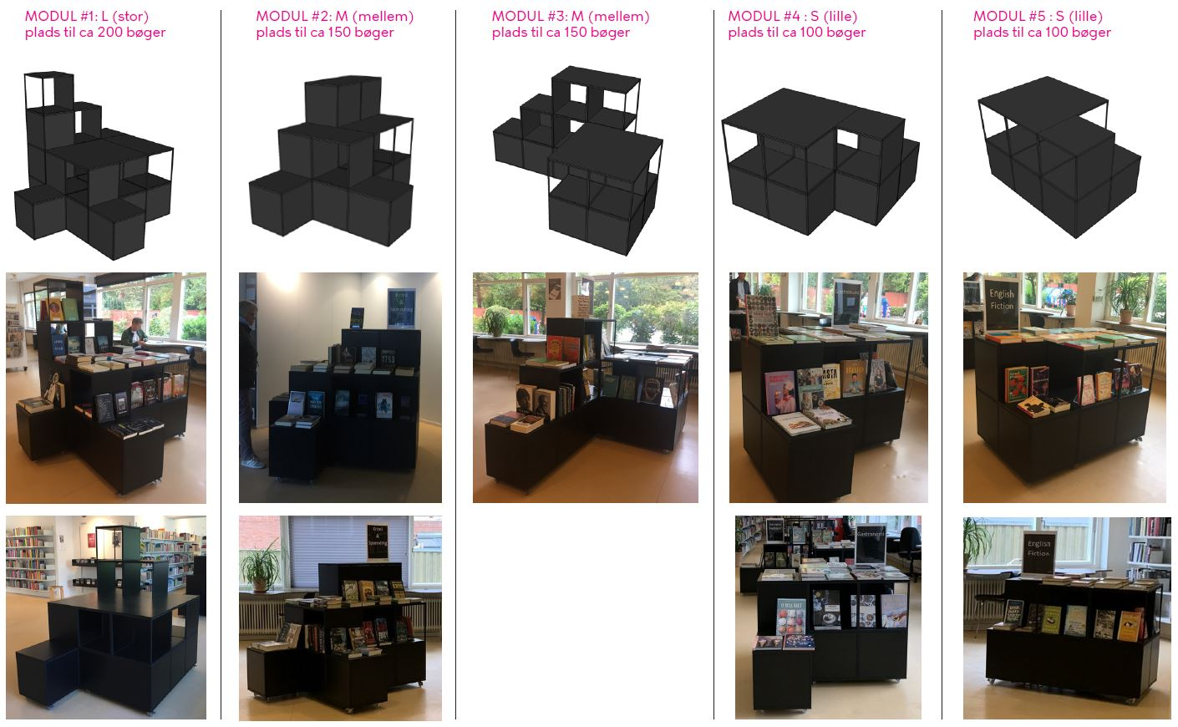
Redesign of the library space
5
The library space is adjusted according to the new initiatives
Joint book displays and logistics demand standardization of library interior
Specialists in interior design analyses each library and make plans for relevant parts of it.
All libraries are get similar workspaces and tools for the logistics tasks.
Book stacks and signs in the collection are adjusted after selected books are moved to the hotel. It frees up the library space for book displays and activities.
All libraries get larger areas with book displays at attractive places in the library space with plenty of room for the displays.
The entrance areas of the libraries are improved
Examples of new podiums for book displays
Large module
Room for app. 150 books
Medium module
Room for app. 100 books
Small module
Room for app. 50 books

Slide 22
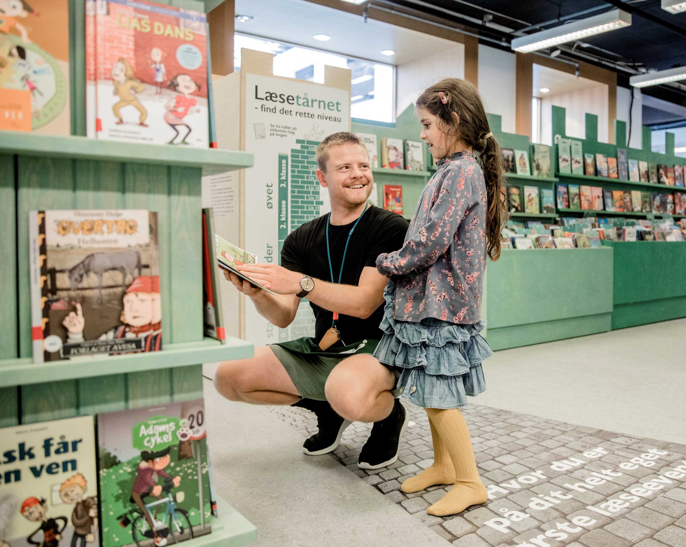
More hospitality
6
Stronger focus on hospitality
The reorganization of logistics and collection management means that focus for at number of employees is moved from the books to the patrons.
Library employees get greater opportunities to focus on patrons and be more welcoming and inviting.
Patrons should experience welcoming and visible employees that can present the offers of the library and inspire to new library experiences.
The many patrons who wants it should have the opportunity to serve themselves both at the physical library and through the digital library.
More hospitality means:
Staff should act as hosts and be welcoming and curios in regard to patrons’ needs and be visible in the library space
Staff that services patrons get better opportunity to provide good service because they don’t have to manage the collection at the same time
Patrons will encounter staff that are more attentive and that contributes to a better library experience
Staff will be wearing clothing signifying their role as library staff and increasing their visibility
Hospitality is supported by active management and training in service

Slide 23
Increase in physical loans
Nationwide increase in physical loans from 2023 to 2024
The increase is primarily driven by an increase in Copenhagen by 350.000 loans, which corresponds to 44% of the total national increase in loans.
Copenhagen also has the biggest increase in loans pr. citizen with an increase in physical loans pr. citizen of 28% over a two-year period.
Increase in physical loans in Copenhagen and the rest of Denmark from 2023 to 2024

Slide 24
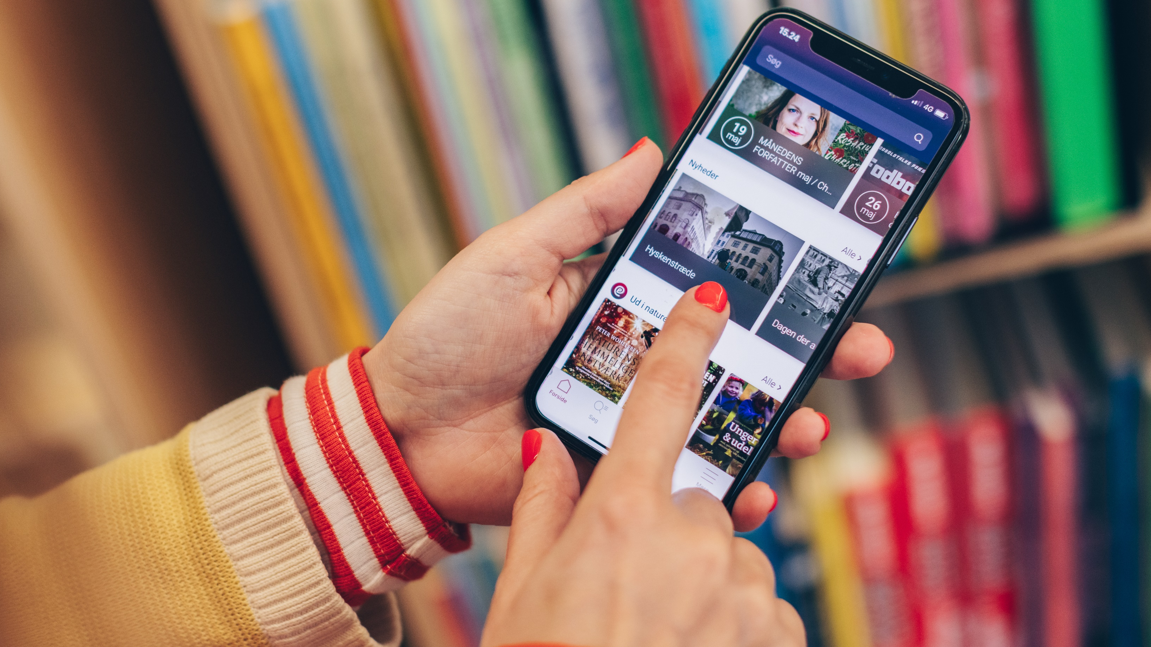
DIGITAL INITIATIVES

Slide 25




Digital services
SoMe & Newsletters
Podcast & eReolen
Call center
Web & App
Web
Search, service
and content hub,
from which content is shared to SoMe and newsletters
App
Service for searching, reservations etc. with national development
Facebook
Source of traffic, activities and live events
Instagram
Visual inspiration
and community engagement
Newsletters
Loyality, exclusivity and community of interest for selected target groups
Podcast
Inspiring listening experiences as an introduction to literature
eReolen+
e-books and audiobooks, podcast-service with national editorial and development
Biblioteket Online
Help, service, support via phone and email

Slide 26
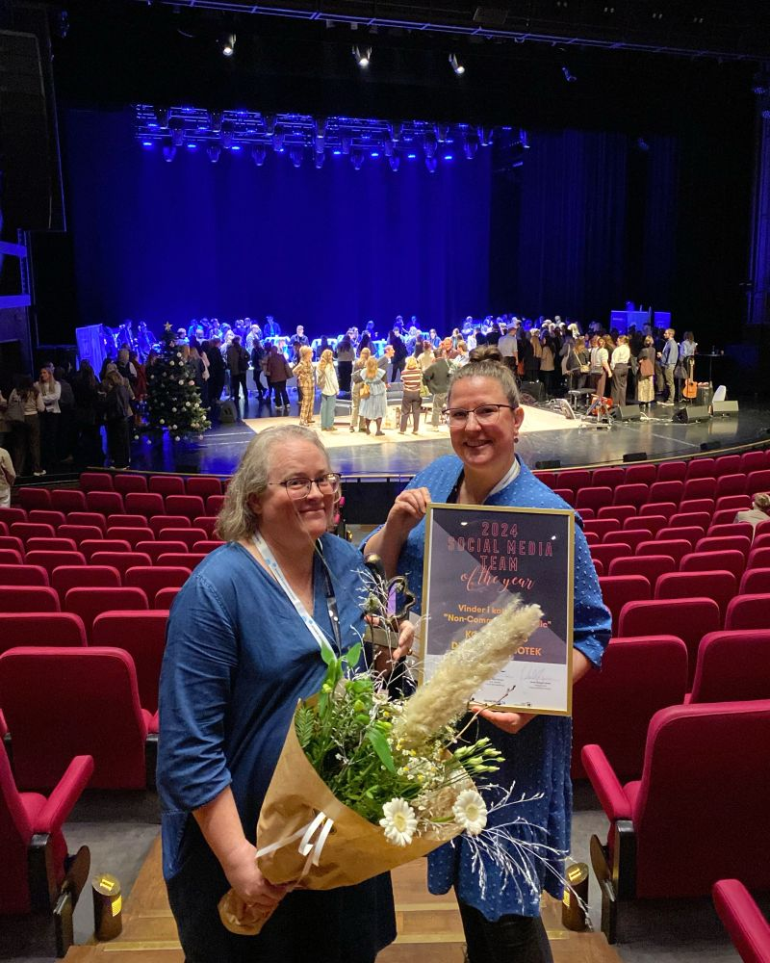
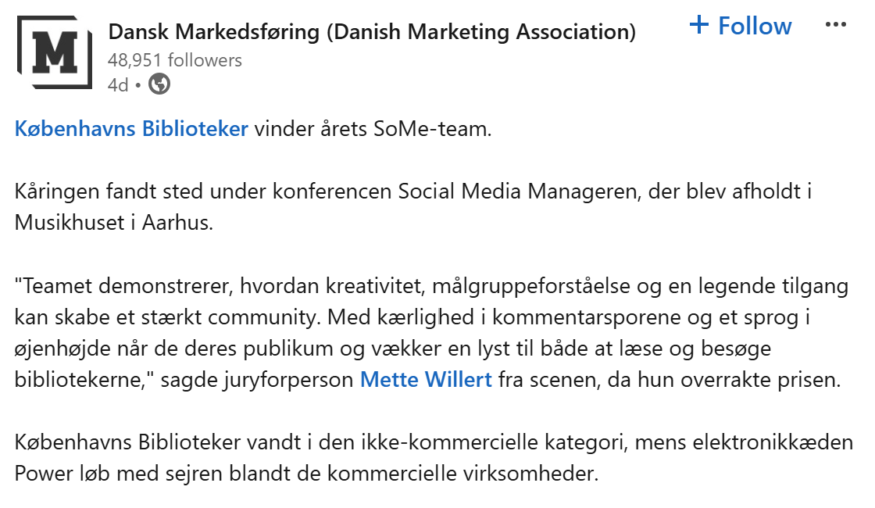
SoMe-team of the year!

Slide 27

Help pages and mail
Digital solutions based on data
Analysis of e-mail inquiries showed that a number of questions should be remedied by a better help page/FAQ section at bibliotek.kk.dk.
The help pages was developed, implemented and adjusted so borrowers got the opportunity to have their questions resolved immediately.
After full implementation, the number of inquiries via email dropped from approx. 8,000 annually (2018) to approx. 2,200 annually (2021), i.e. a decrease of 75%.

Slide 28




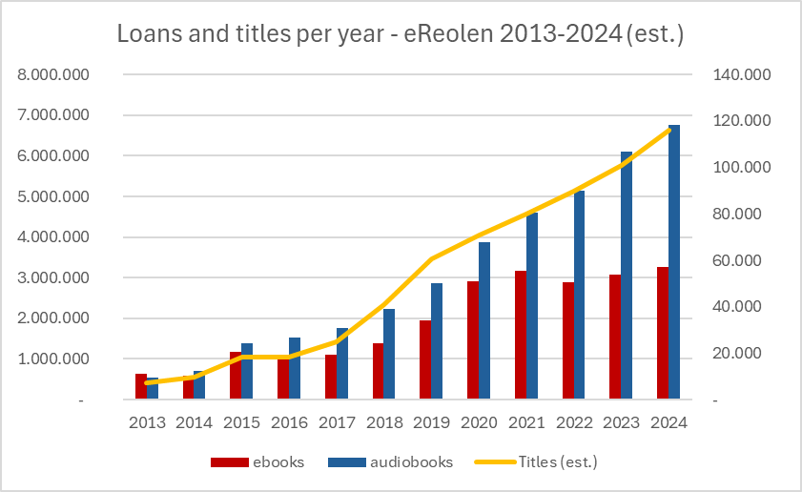
Public e-book service since 2011
Challenge/goal
Attention economy and crowded media landscape. Maintain literature as part of citizens' daily life and contribute to children's reading and education
Development of use and content 2013-2024
e-Reolen
The public libraries own the IT-platform, negotiate and buy directly from the publishers and authors
Independent of commercial services – which enables:
  Flexible lending models and targeted library presentation and design contribute to coexistence with the commercial market
  Contribution to the digitation of the Danish back catalogue by guaranteeing public sector demand
  Contribution to self-publishers and small publishers being able to exist and develop in a competitive market
Notes:
Udsprunget af, at læsning og den fysiske bog udfordres af den digitale opmærksomhedsøkonomi: nem tilgængelighed og tilstedeværelse, hvor borgerne er (digitalt)
Fælleskommunal løsning drevet af folkebibliotekerne → nationalt tilbud. Begrænsninger på lån varetages i de enkelte kommuner og er afhængig af økonomi.
Ønske om et bibliotekarisk produkt med formidling og kurateret indhold – ikke et kommercielt: folkebibliotekerne gik sammen om at udvikle e-reolen
eReolen har egen it-platform 2011 og eget forhandling og indkøb direkte fra forlag og forfattere (platform og indhold er ellers ofte udbydes samlet af kommercielle aktører)
Fleksible udlånsmodeller og speciel formidling bidrager til sameksistens med markedet
Bidrag til digitalisering af bagkatalog (DK lille sprogområde) ved indkøb af titler på forhånd. Back catalouge= books no longer available on the market and not digitazed - such as classics, requested books, recent cultural heritage etc.
Bidrager til at selvudgivere og små forlag kan eksistere og udvikle sig ved at tilbyde et alternativt formidlingsplatform, der ikke udbydes af kommercielle tjenester. De tilbydes en digital platform og direkte betaling for anvendelsen af deres bøger på baggrund af forhandling med eReolen.
eReolen er for alle, men mest henvendt til voksne. eReolen GO er målrettte børn med indhold og formidling – herunder børn-børn formidling bl.a. i form af anbefalinger

Slide 29
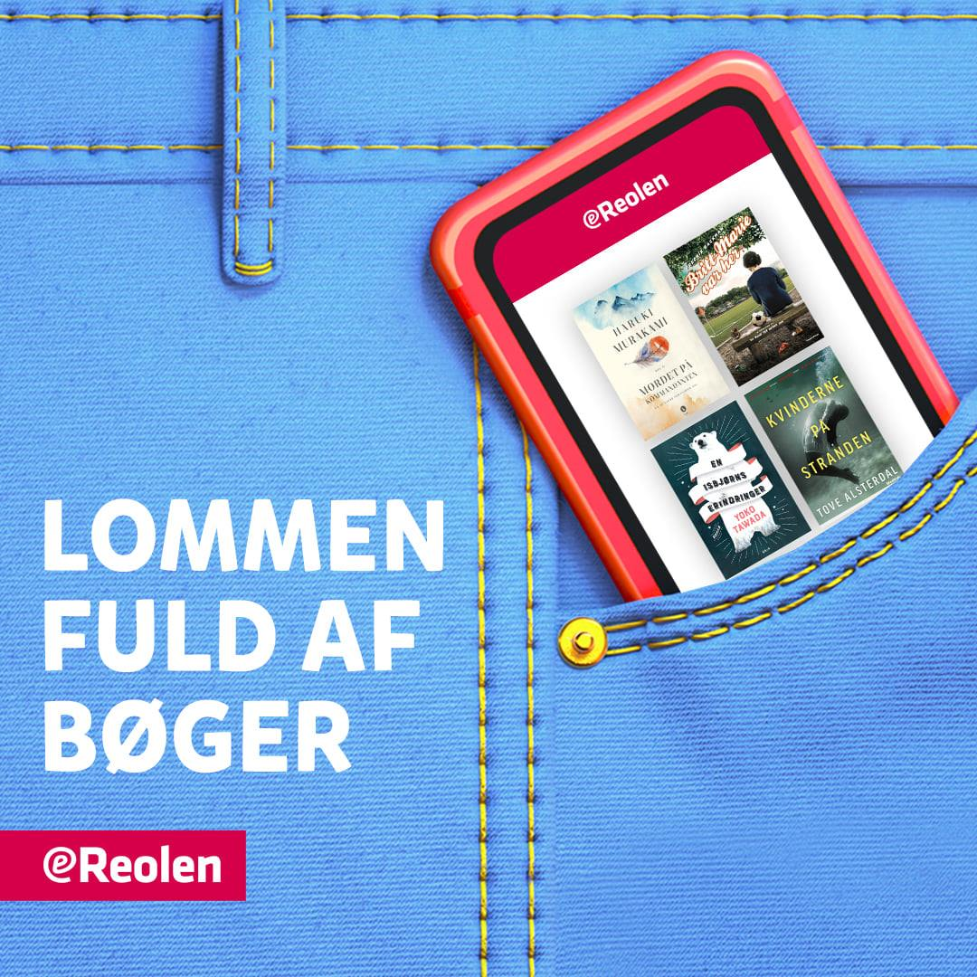
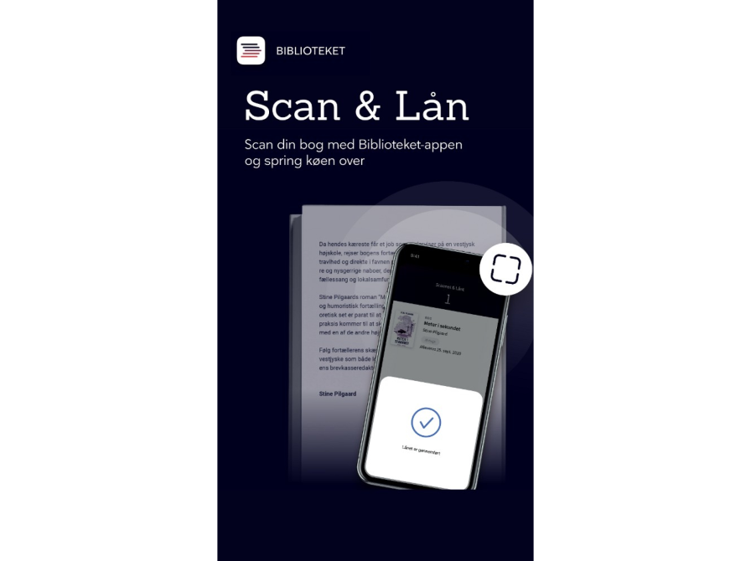
Trends in digital library services
Decreasing relevance of library homepage
  Passive platform where staff time should be reduced
Increasing relevance of library apps
  Optimal for digital book consumption
  Superior convenience compared to web in handling transactions with physical books (search, check-out, reservations, notifications)
Increasing relevance of SoMe and newsletters
  Patrons get their inspiration for reading from SoMe
  Limited organic reach, need for paid advertisement
  Increasing relevance of newsletters
Data-analysis and professional specialization of staff increasingly important

Slide 30

Summary
Library plan
  Focus on literature and children
  Exploiting specialization and economics of scale
Development of core library operations
  Central sorting facility and book hotel
  Division of books in storage and off-the-shelf items
  Increased use of book displays
  Reorganization of logistics and collection management
  Redesign og the library space in local branches
  More hospitality
Developing digital services through data based on patrons’ preferences

