Slide 1

Community Co-Creation: The role of culture institutions in supporting immigrants’ integration
Anna Wojtynska, University of Iceland
Lara Hoffmann, University of Iceland, University of Akureyri

Slide 2
Project “Community Co-Creation”
Spring 2022 – Autumn 2024
Collaboration between University of Iceland and Reykjavik City Library (Lara Hoffmann, Anna Wojtyńska, Dögg Sigmarsdóttir)
Partner institutions:
  Municipal Library of Akureyri (Akureyri)
  The Library of Rangæinga (Hvolsvöllur),
  The Library of Héraðbúa (Egilsstaðir)
  Húsavík Library
  Ísafjörður Library
  Kaktus (Akureyri)
  The Museum of Everyday Life (Ísafjörður)
  The Blue Bank (Þingeyri)
  Sláturhúsið (Egilsstaðir)
  Funding: Bókasafnasjóður and Byggðarannsóknasjóður

Slide 3
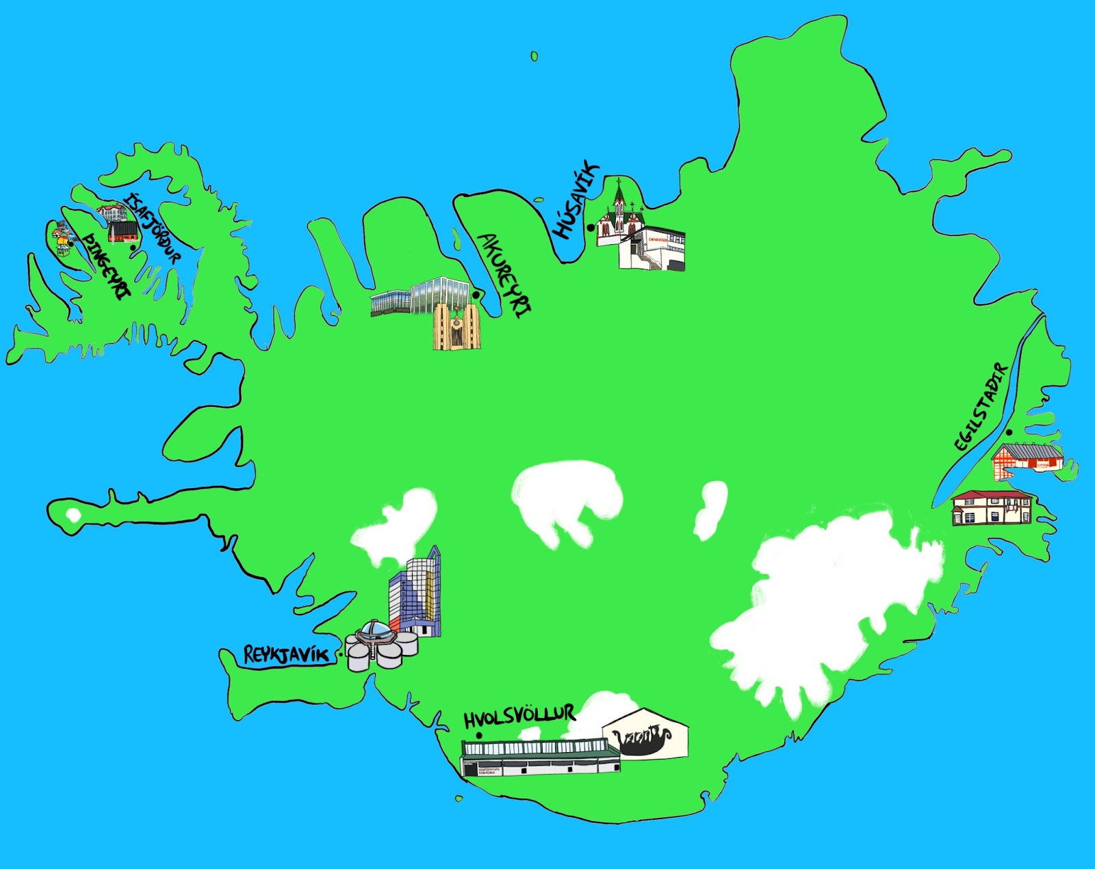

Slide 4
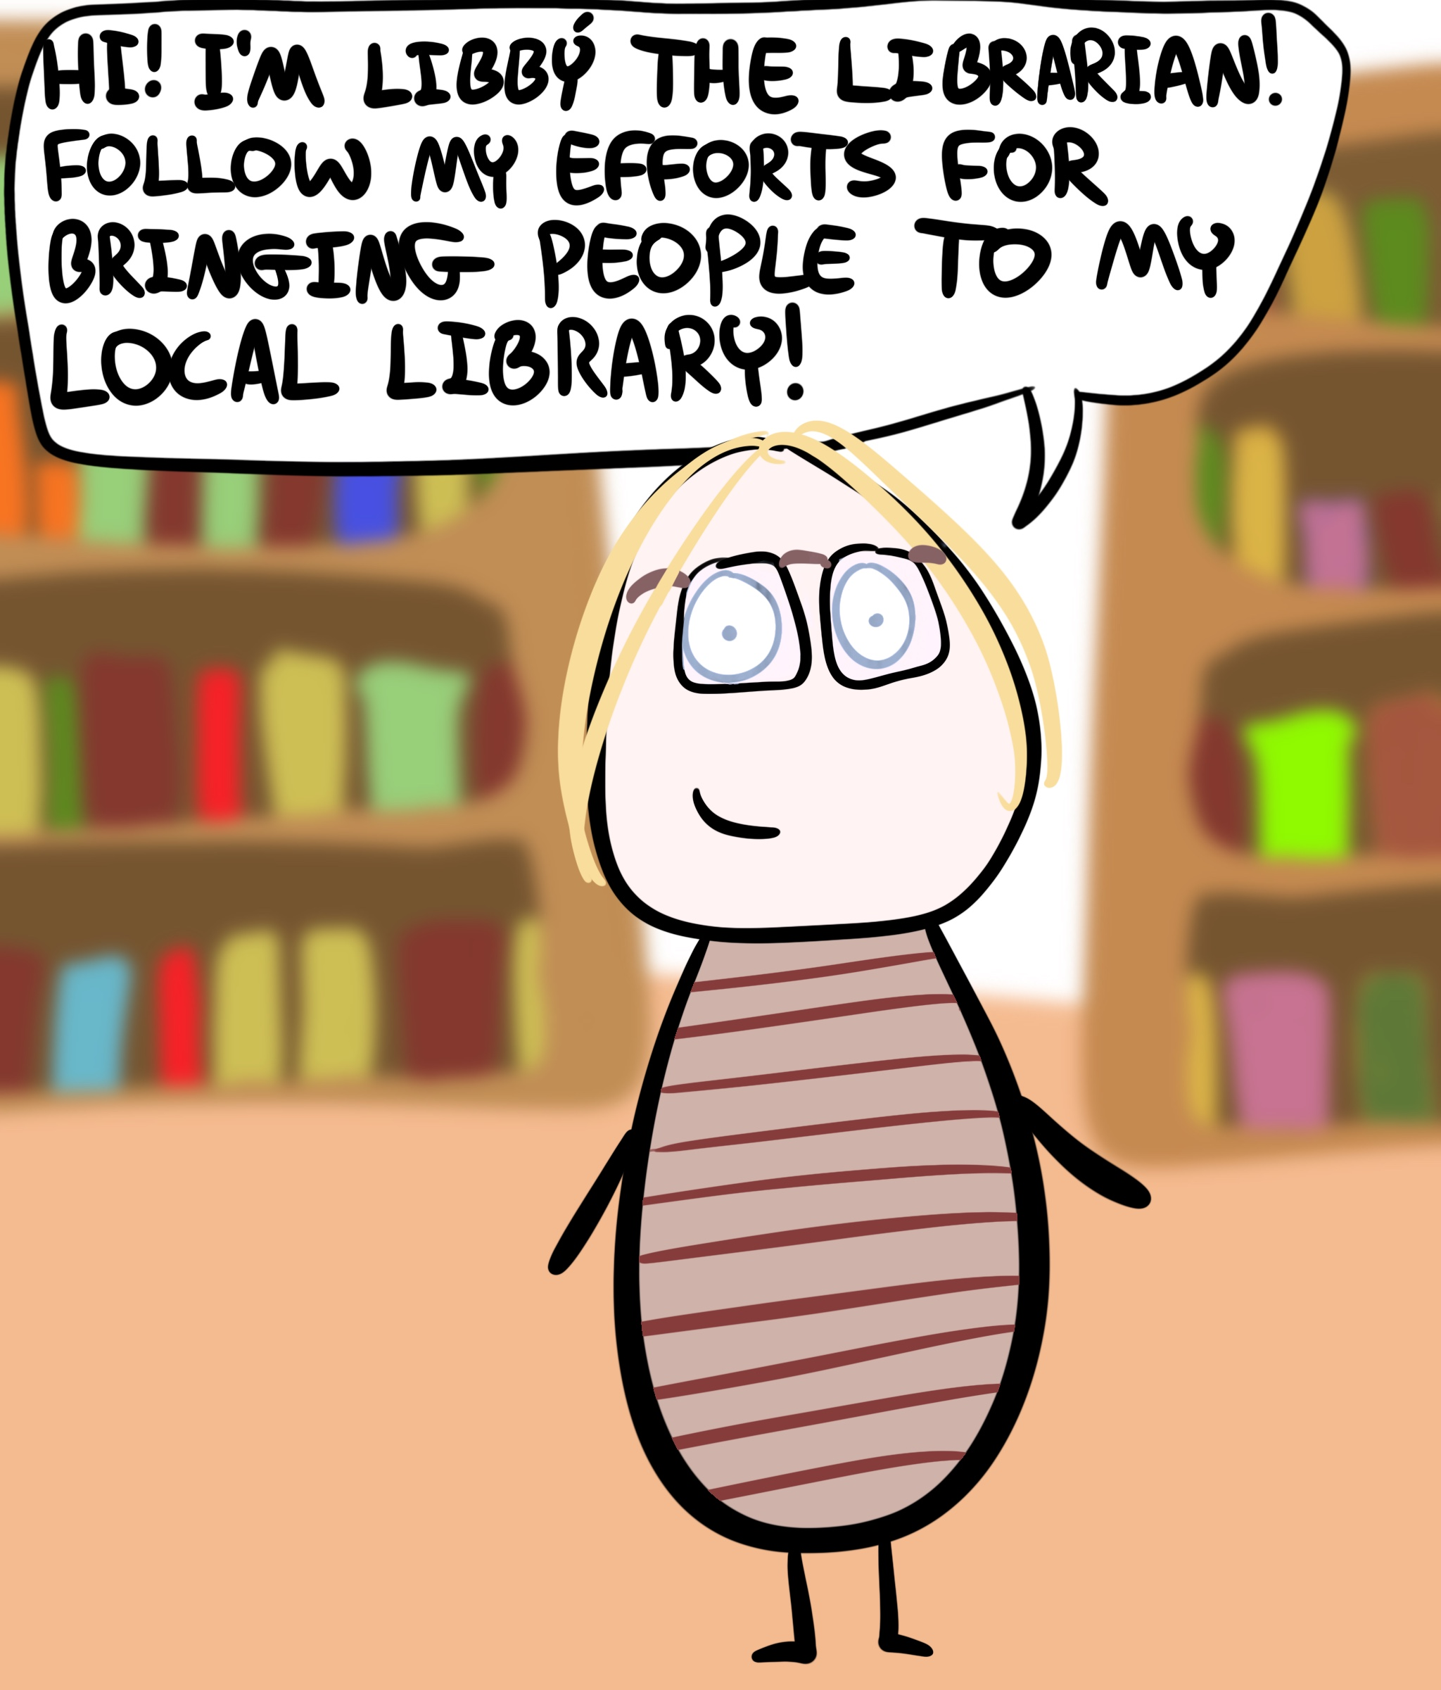
Upcoming Report
Illustrator: Yoav Tirosh
@RealMundiRiki

Slide 5
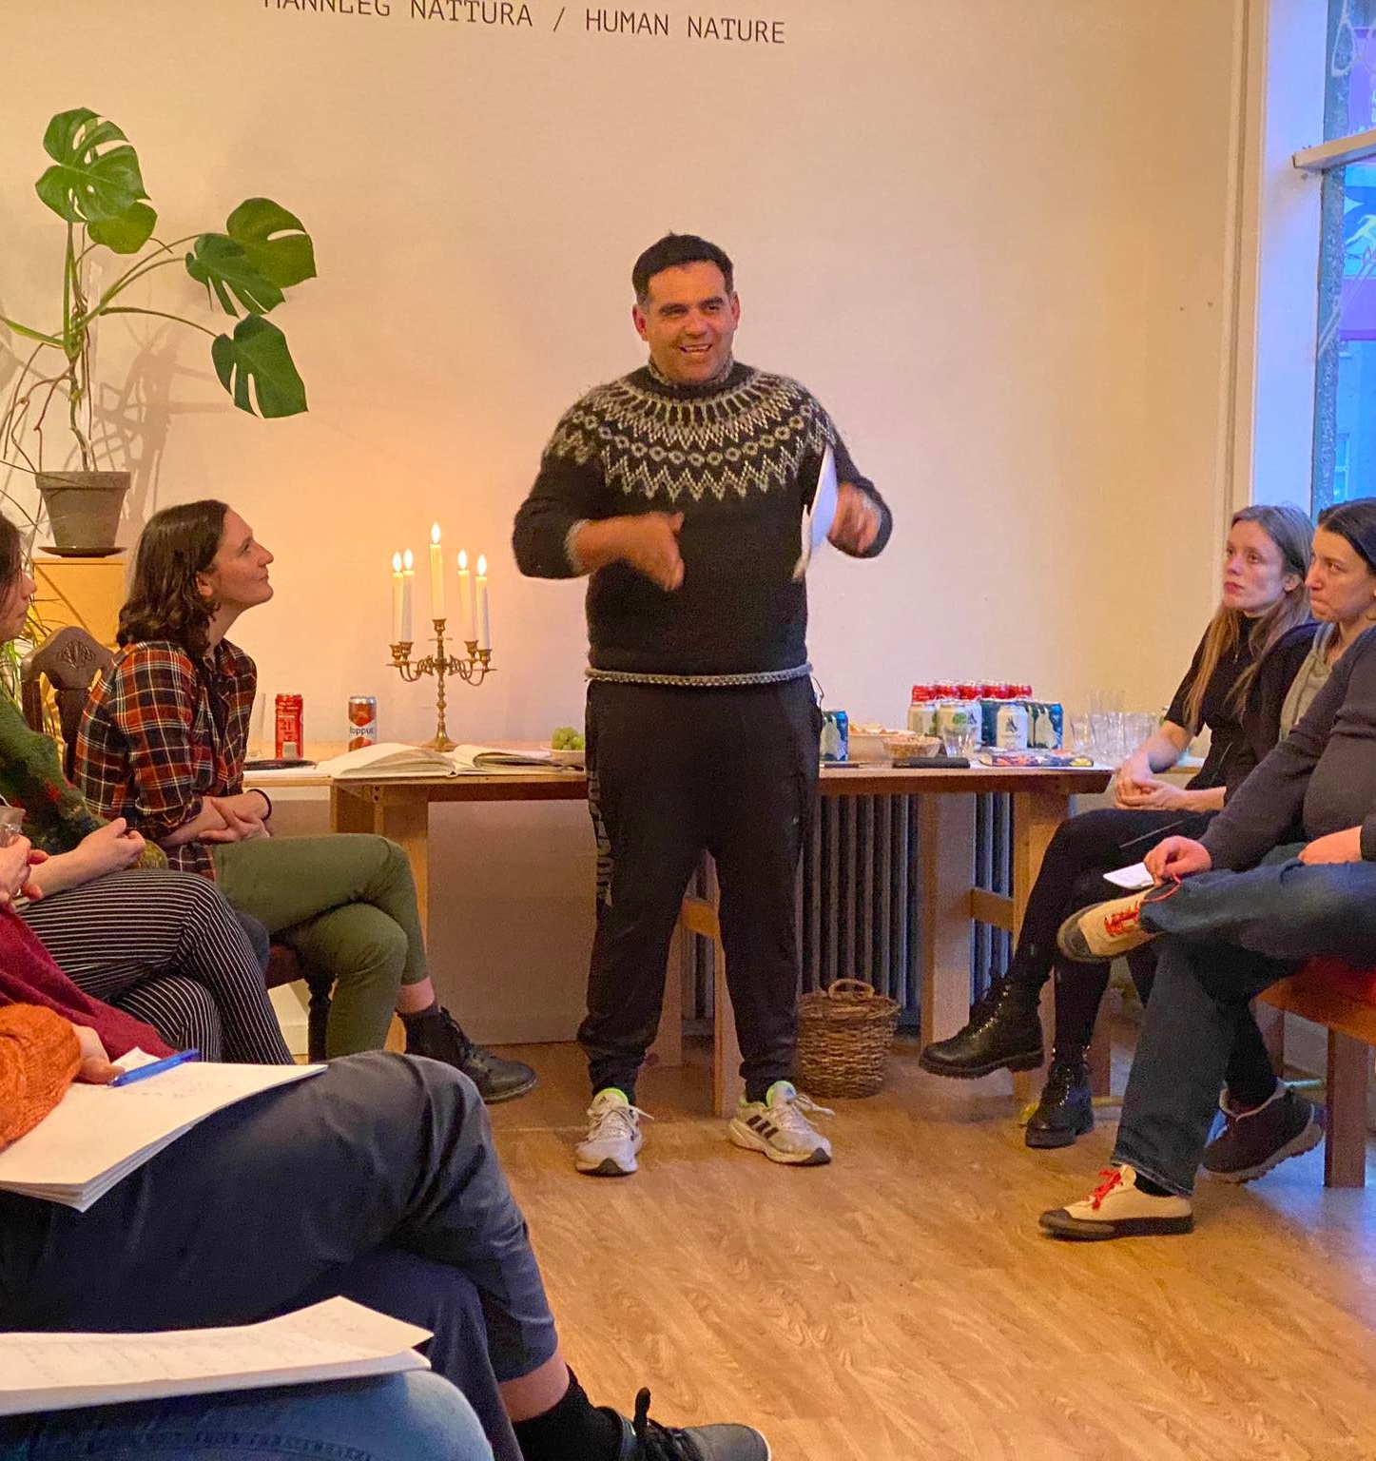
Community
Apparent challenges to local communities:
  Increased different forms of mobilities (migration and tourism)
  Growing ethnic diversity
  Polarization of the labour market and social segmentation
  Advancement of information and communication technology
  Social acceleration (Hermut Rosa, 2013): frenetic time; speed that contributes to social alienation
  Diminishing/changing social infrastructure
Community as a value
  Beyond financial profit
  Well-being
  Security
  Social cohesion
  Building on the work of Ash Amin (2002) and Doreen Massey (2004), we understand community not as a homogeneous and stable, but rather as an ongoing process; one that is created through social interactions and continues negotiations of differences.
  Community co-creation as model of immigrant inclusion

Slide 6
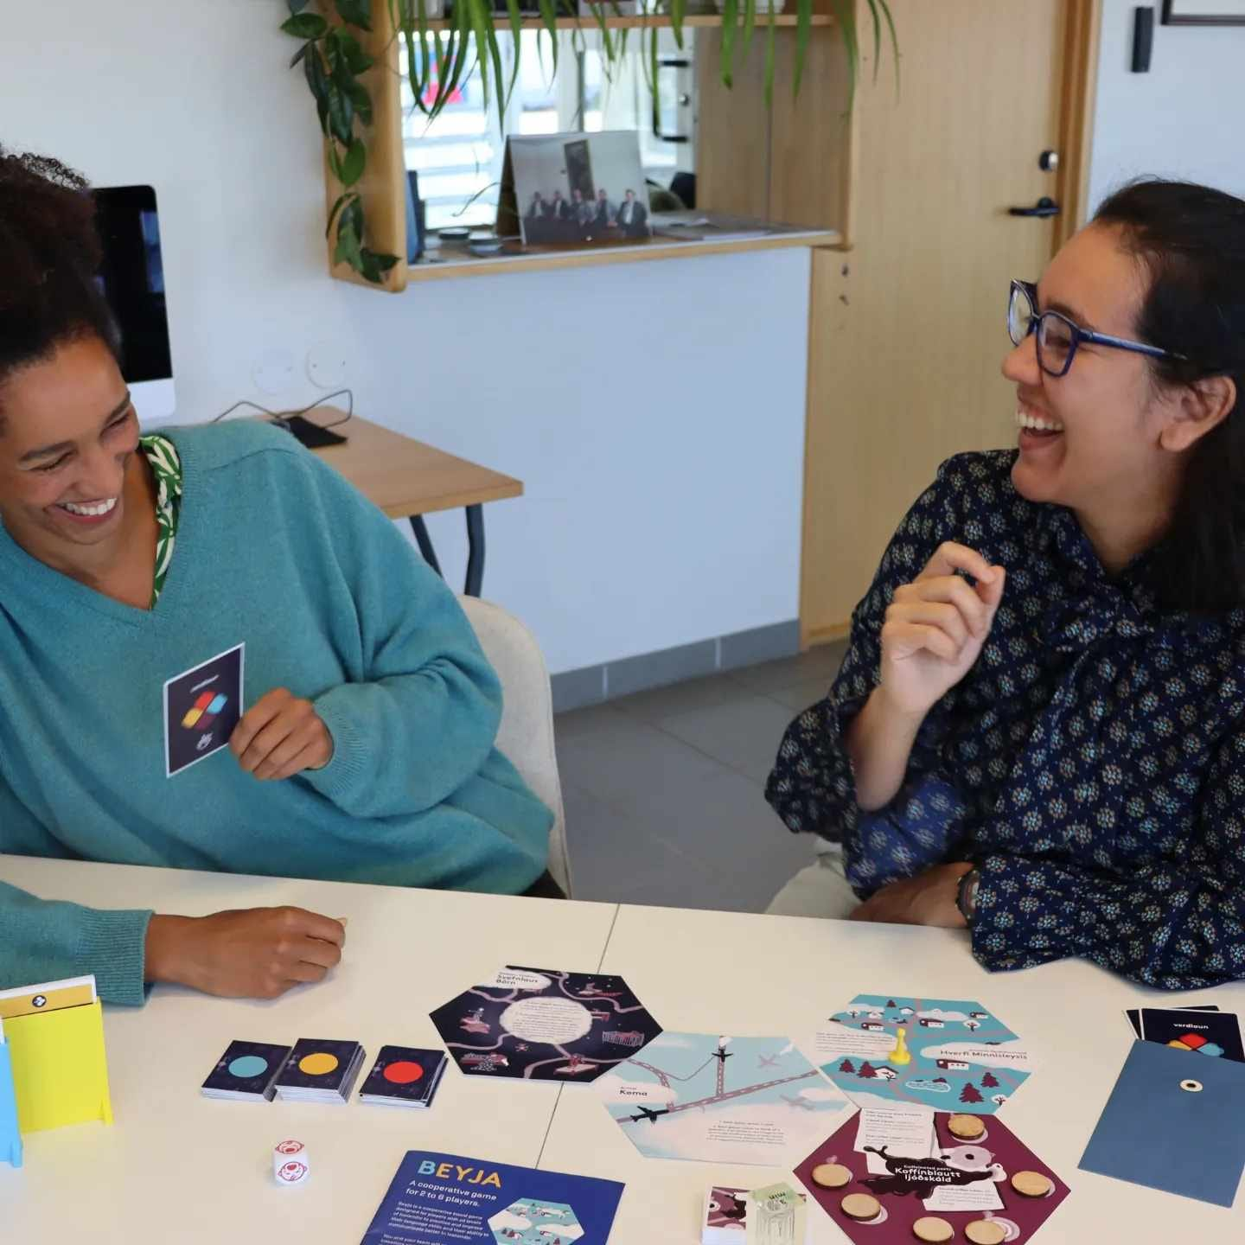
Social Infrastructure
Social spaces are “physical places and organizations that shape the way people interact (…) People forge bonds in places that have healthy social infrastructure – not because they set out to build community, but because when people engage in a sustained, recurrent interaction, particularly while doing things they enjoy, relationships inevitably grow.”
E. Klinenberg, Palaces for the people, 2018, p.5
How do you create places of encounters?
On who’s terms are you interacting?
Can social spaces embrace ongoing social fluidity?

Slide 7
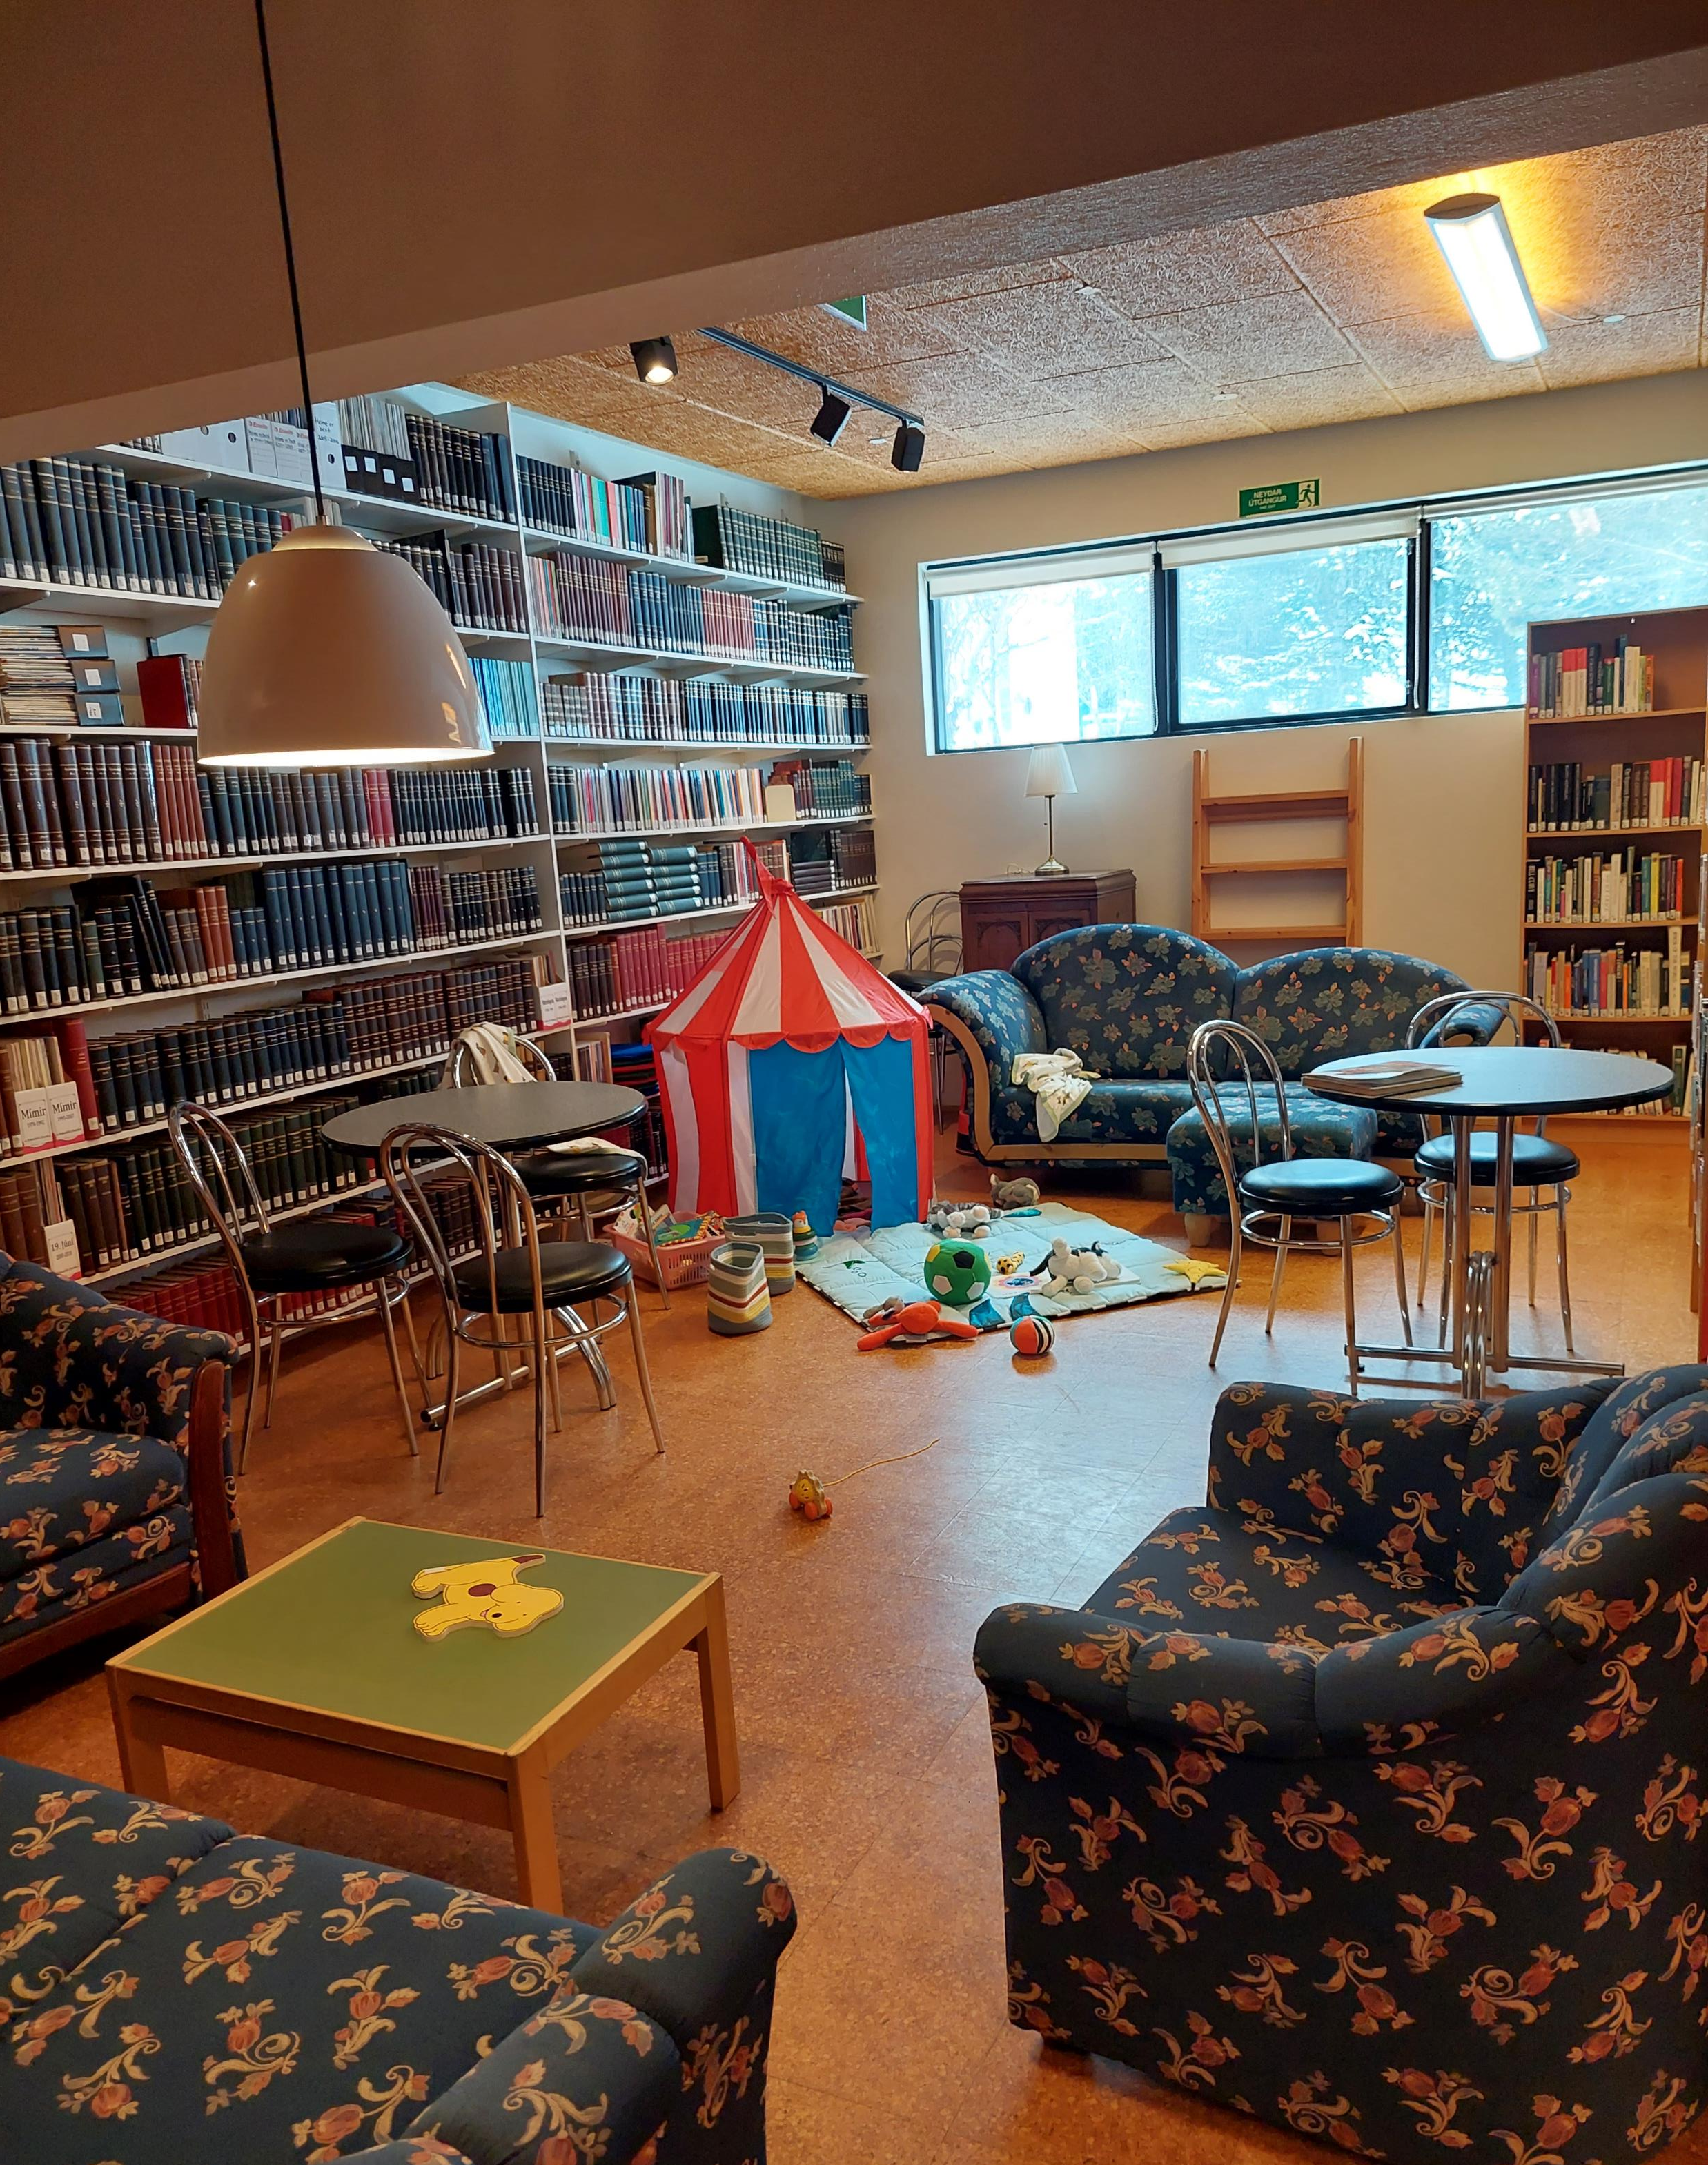
Challenges
Limited resources: Time, People, Money, Space

Slide 8
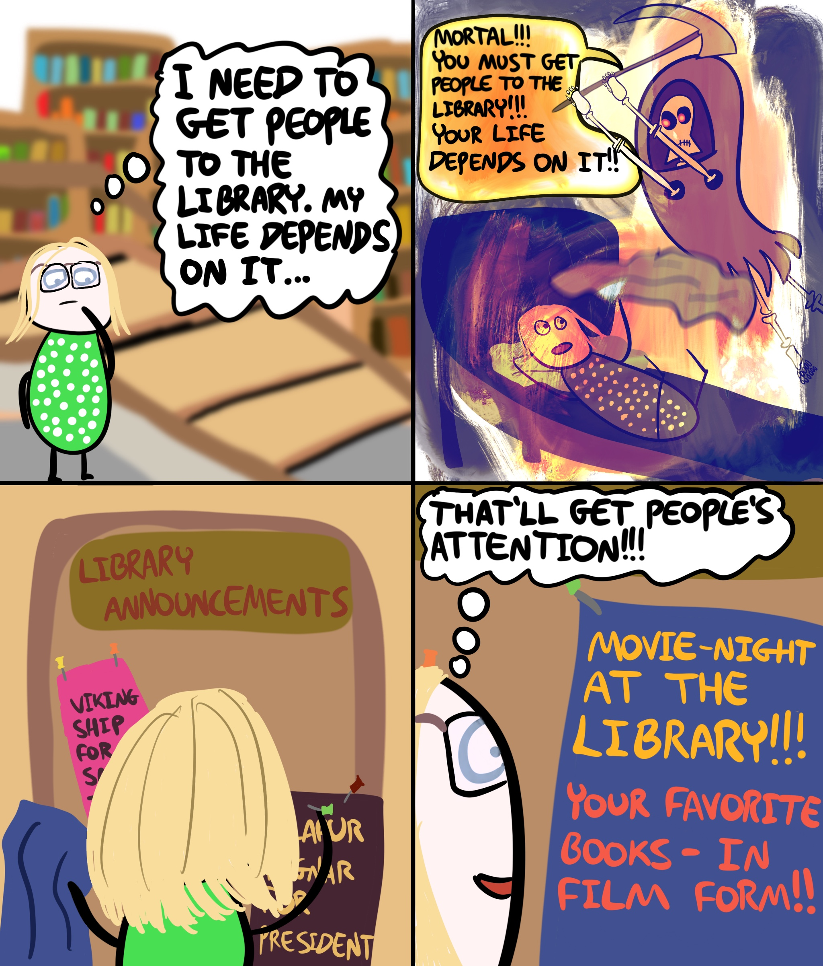
Low Attendance – Reaching Out
"We had this project last year on feeling at home in a place. We needed 12 women, some came but others withdrew from the project, then we really had to go and bring them in. One of our staff drove to another municipality to get a participant. We put in a lot of effort to get the participants from other municipalities."

Slide 9
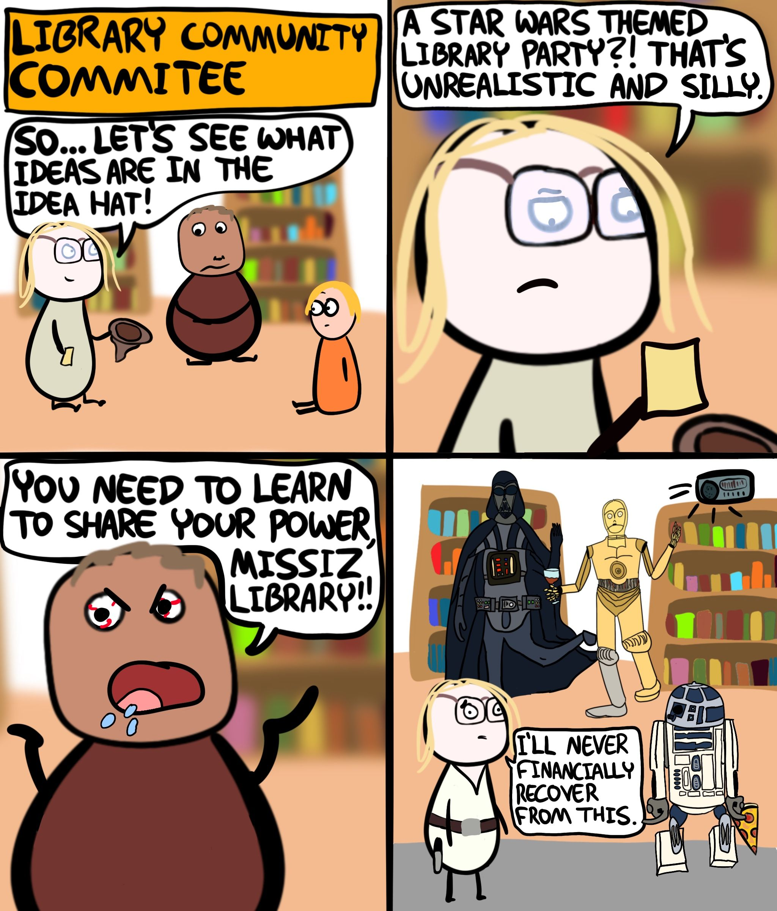
Sharing Ownership

Slide 10
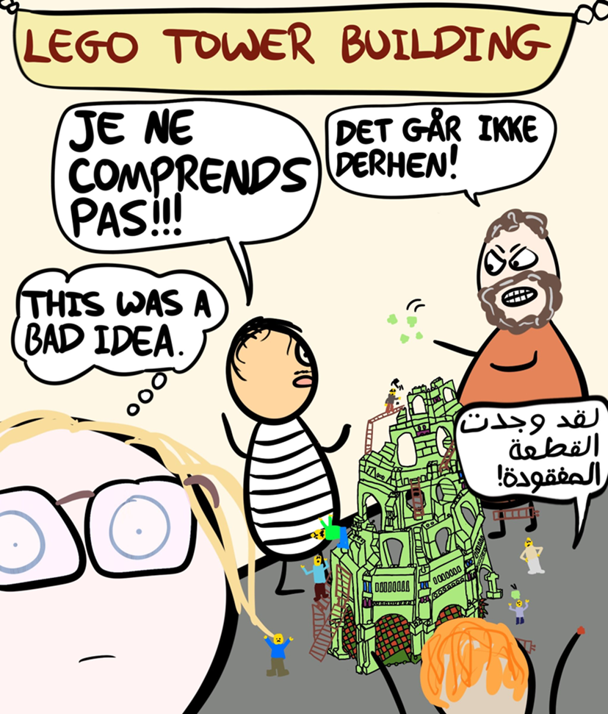
Losing control

Slide 11
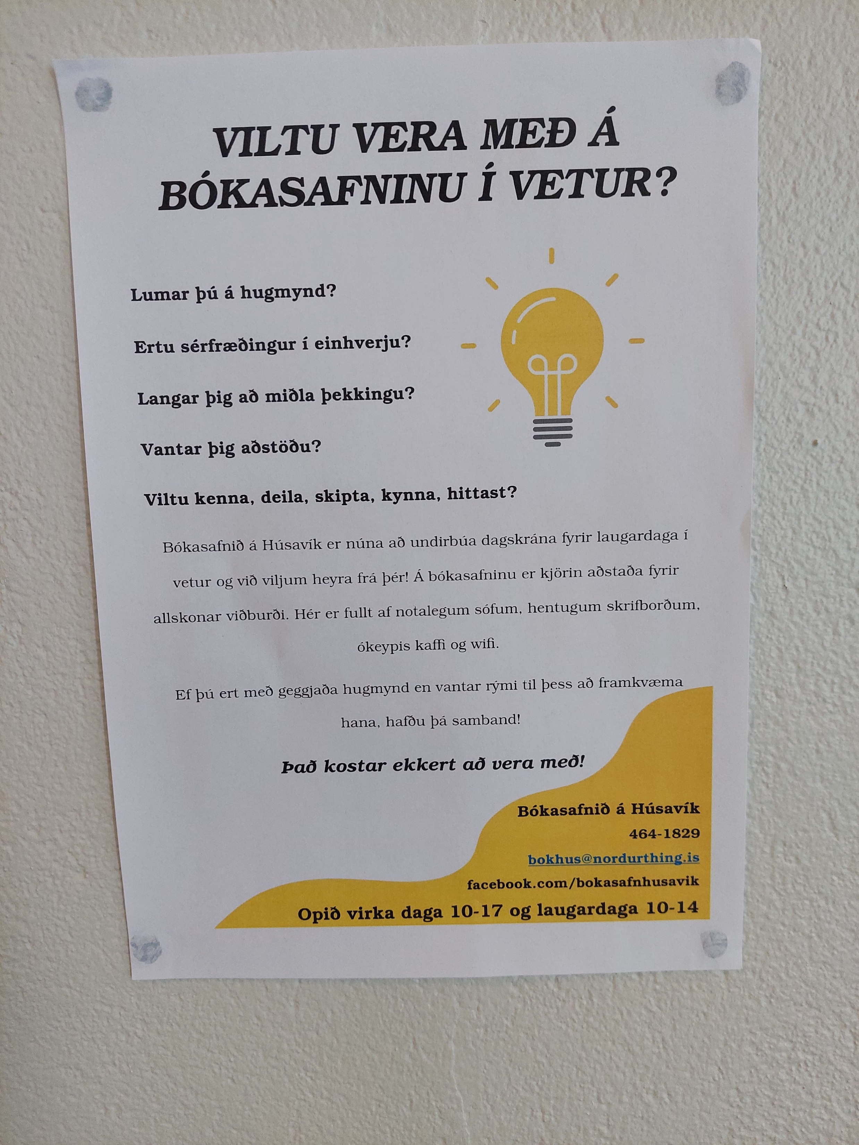
Co-Created Programming
  Bottom – up approach to cultural programming
  Hands over part of the authority to community members
Collaborating with partners in the local community - “equitable decision-making powers" over the space and activities.
Representation matters

Slide 12
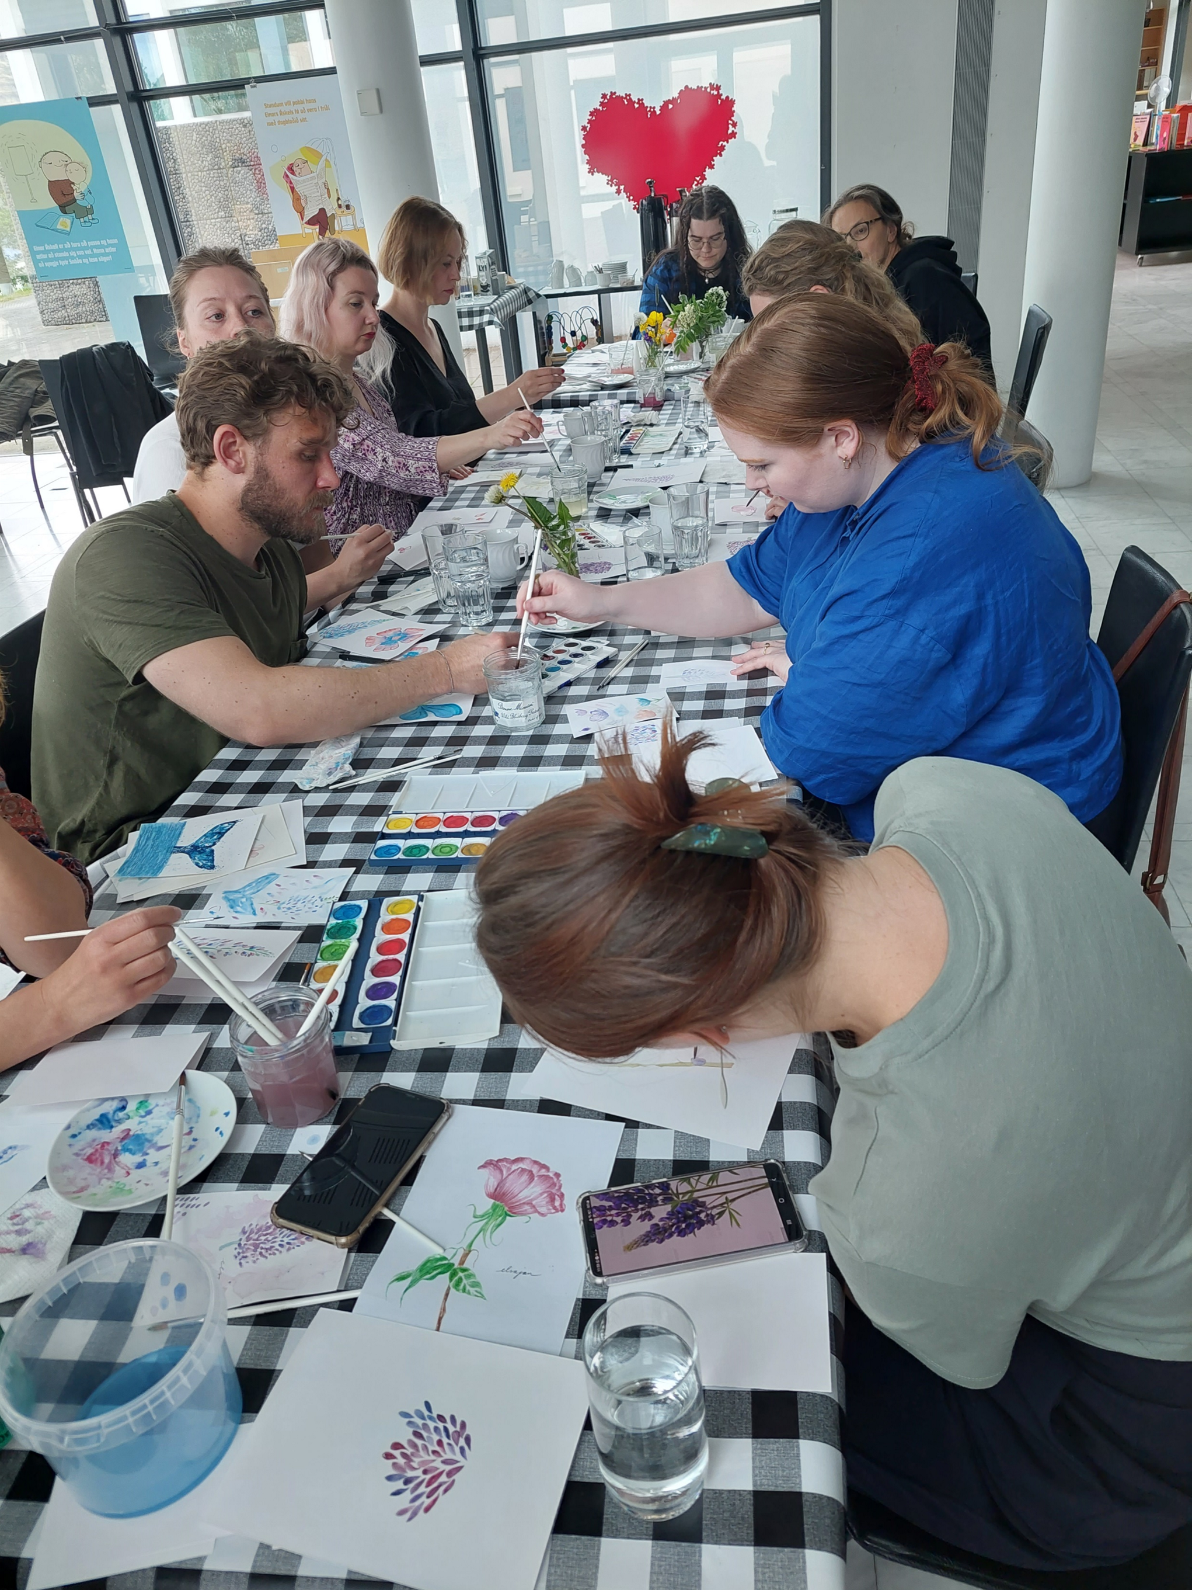
Art and Creative Methods I
Art and creative projects can facilitate social bonding and bridging cohesive behavior between and within different groups (Otte, 2019).
Creative projects and art and literature can offer empowering spaces where migrants can participate in society on more equal terms, express their stance, contest simplified imaginaries about migration and mobile subjects, reclaim their agency, and advocate for change (Jeffery et al., 2019).
Can provide structure that welcomes creativity
Potential for meaningful encounters
Communication beyond languages

Slide 13
Recommendations
Don’t be limited by limited space: Is there a possibility to organize events outside of the library space or use available space creatively?
Learn from your neighbours: Can you ask the people in your place of residence what kind of events they would like to see and what they could possibly contribute?
Collaborate with the target group: Is there a person in your community who belongs to the group the event is intended for who can help organize and facilitate the event?
Continuity and consistency: Regular events benefit community-building, if people in the community understand that, for example, your institution offers weekly events, they are more likely to participate.
Draw on the power of art: Can you use creative methods to facilitate spaces and encounters where language and linguistic differences become less important?
Think outside the (finance) box: Can you pair up with other institutions (in Iceland or abroad) and apply for funding?
Think long-term: It takes time to build community, are you prepared to wait, hang in there and let things develop?
Trust the process: As this guidebook shows, there are countless examples of successful initiatives and how small steps can make a difference to individuals and communities.

Slide 14
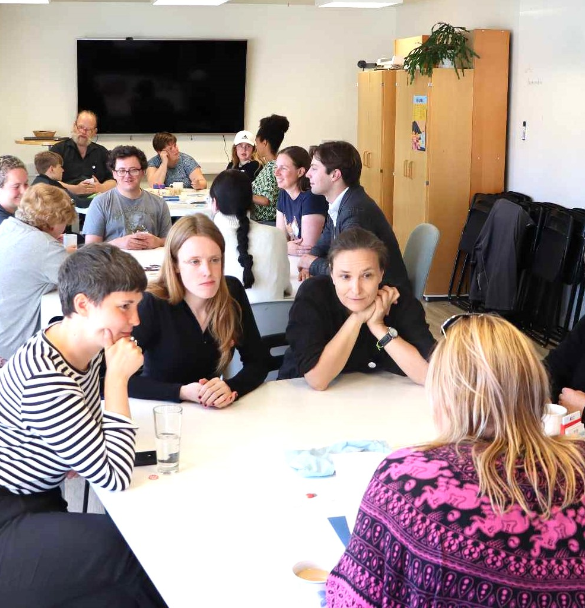
Concluding remarks
“The library plays a perfect role in creating an open public space. Also with the new type of events (...), where English speaking people are also engaging. I would not say that we (as an independent museum) could be that institution. It could only work if we would be open all year around and be supported by the municipality." (Ísafjörður)
"In creating a new strategy plan for the library, we needed to speak to get ideas from people who are not the staff or already using the library today." (Akureyri)

Slide 15

Thank you!
Further information:
Anna Wojtynska - wojtynska@hi.is
Lara Hoffmann - laraw@hi.is
Illustrator: Yoav Tirosh
@RealMundiRiki

